Slide 1
Lamar PTO Meeting
September 28, 2021

Slide 2
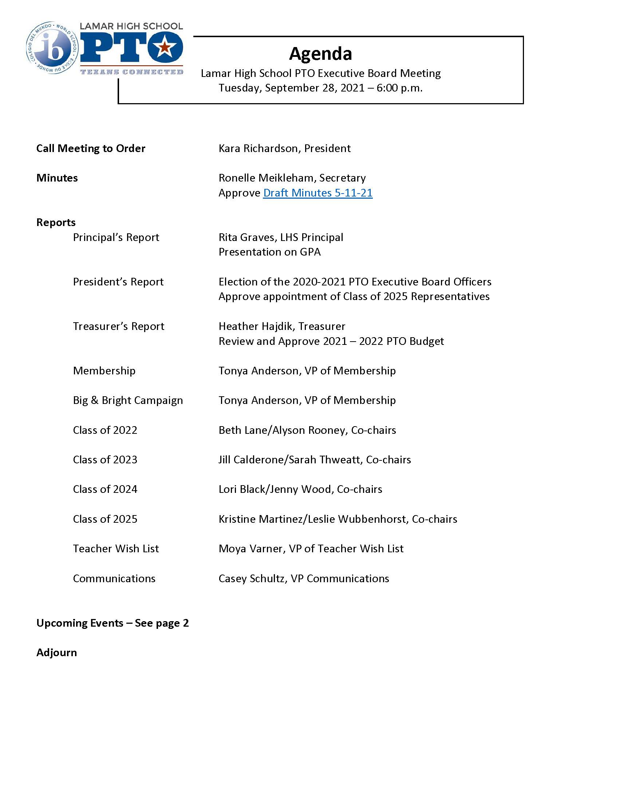
Agenda

Slide 3
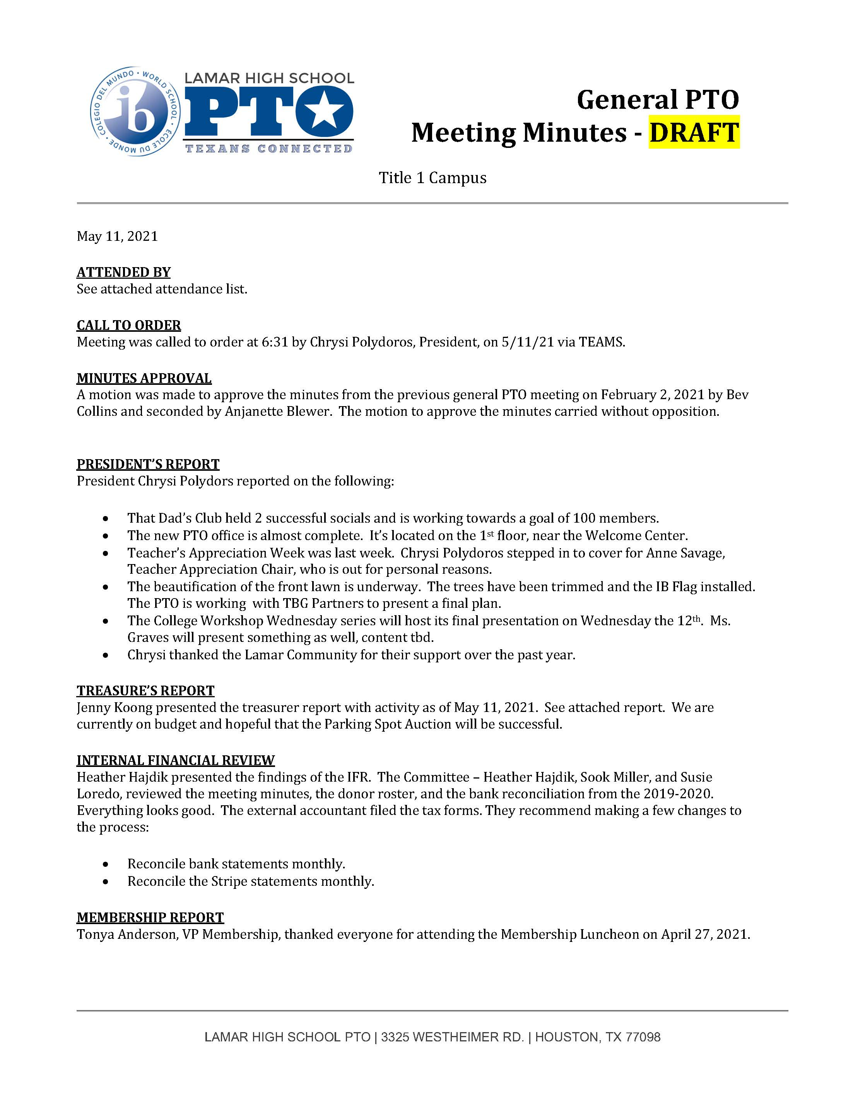
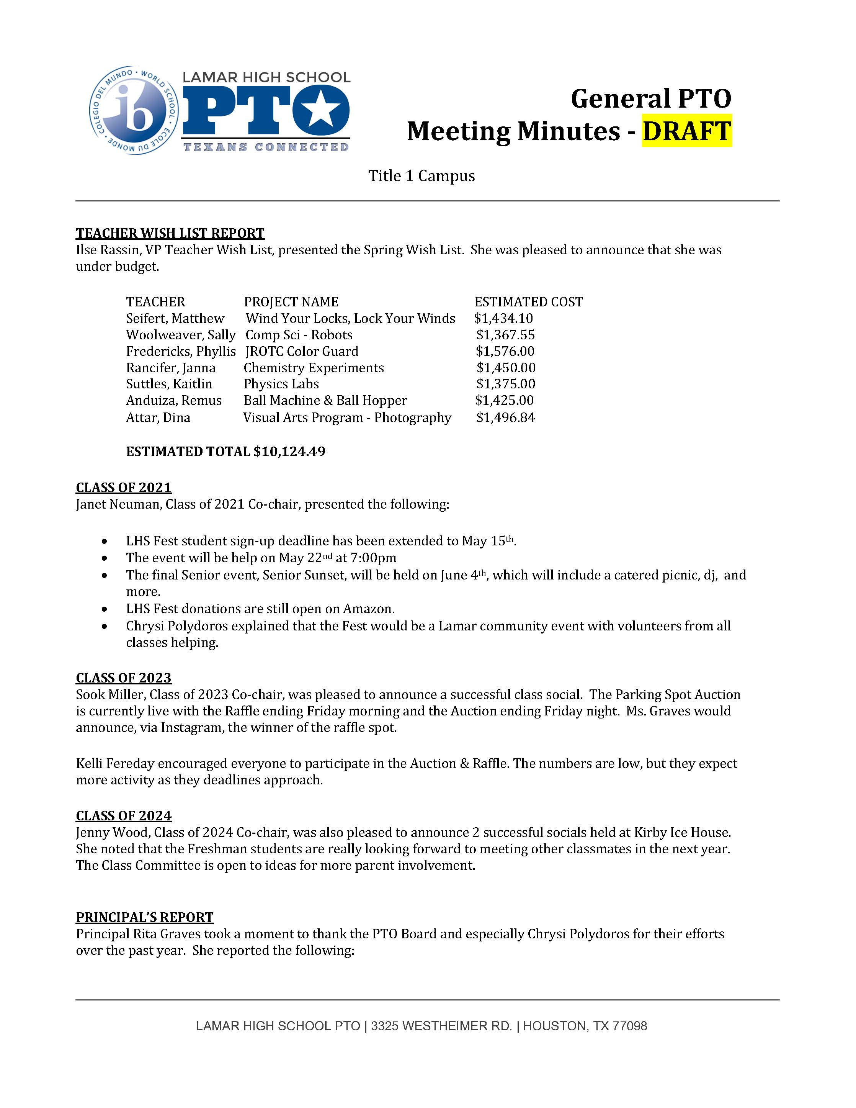
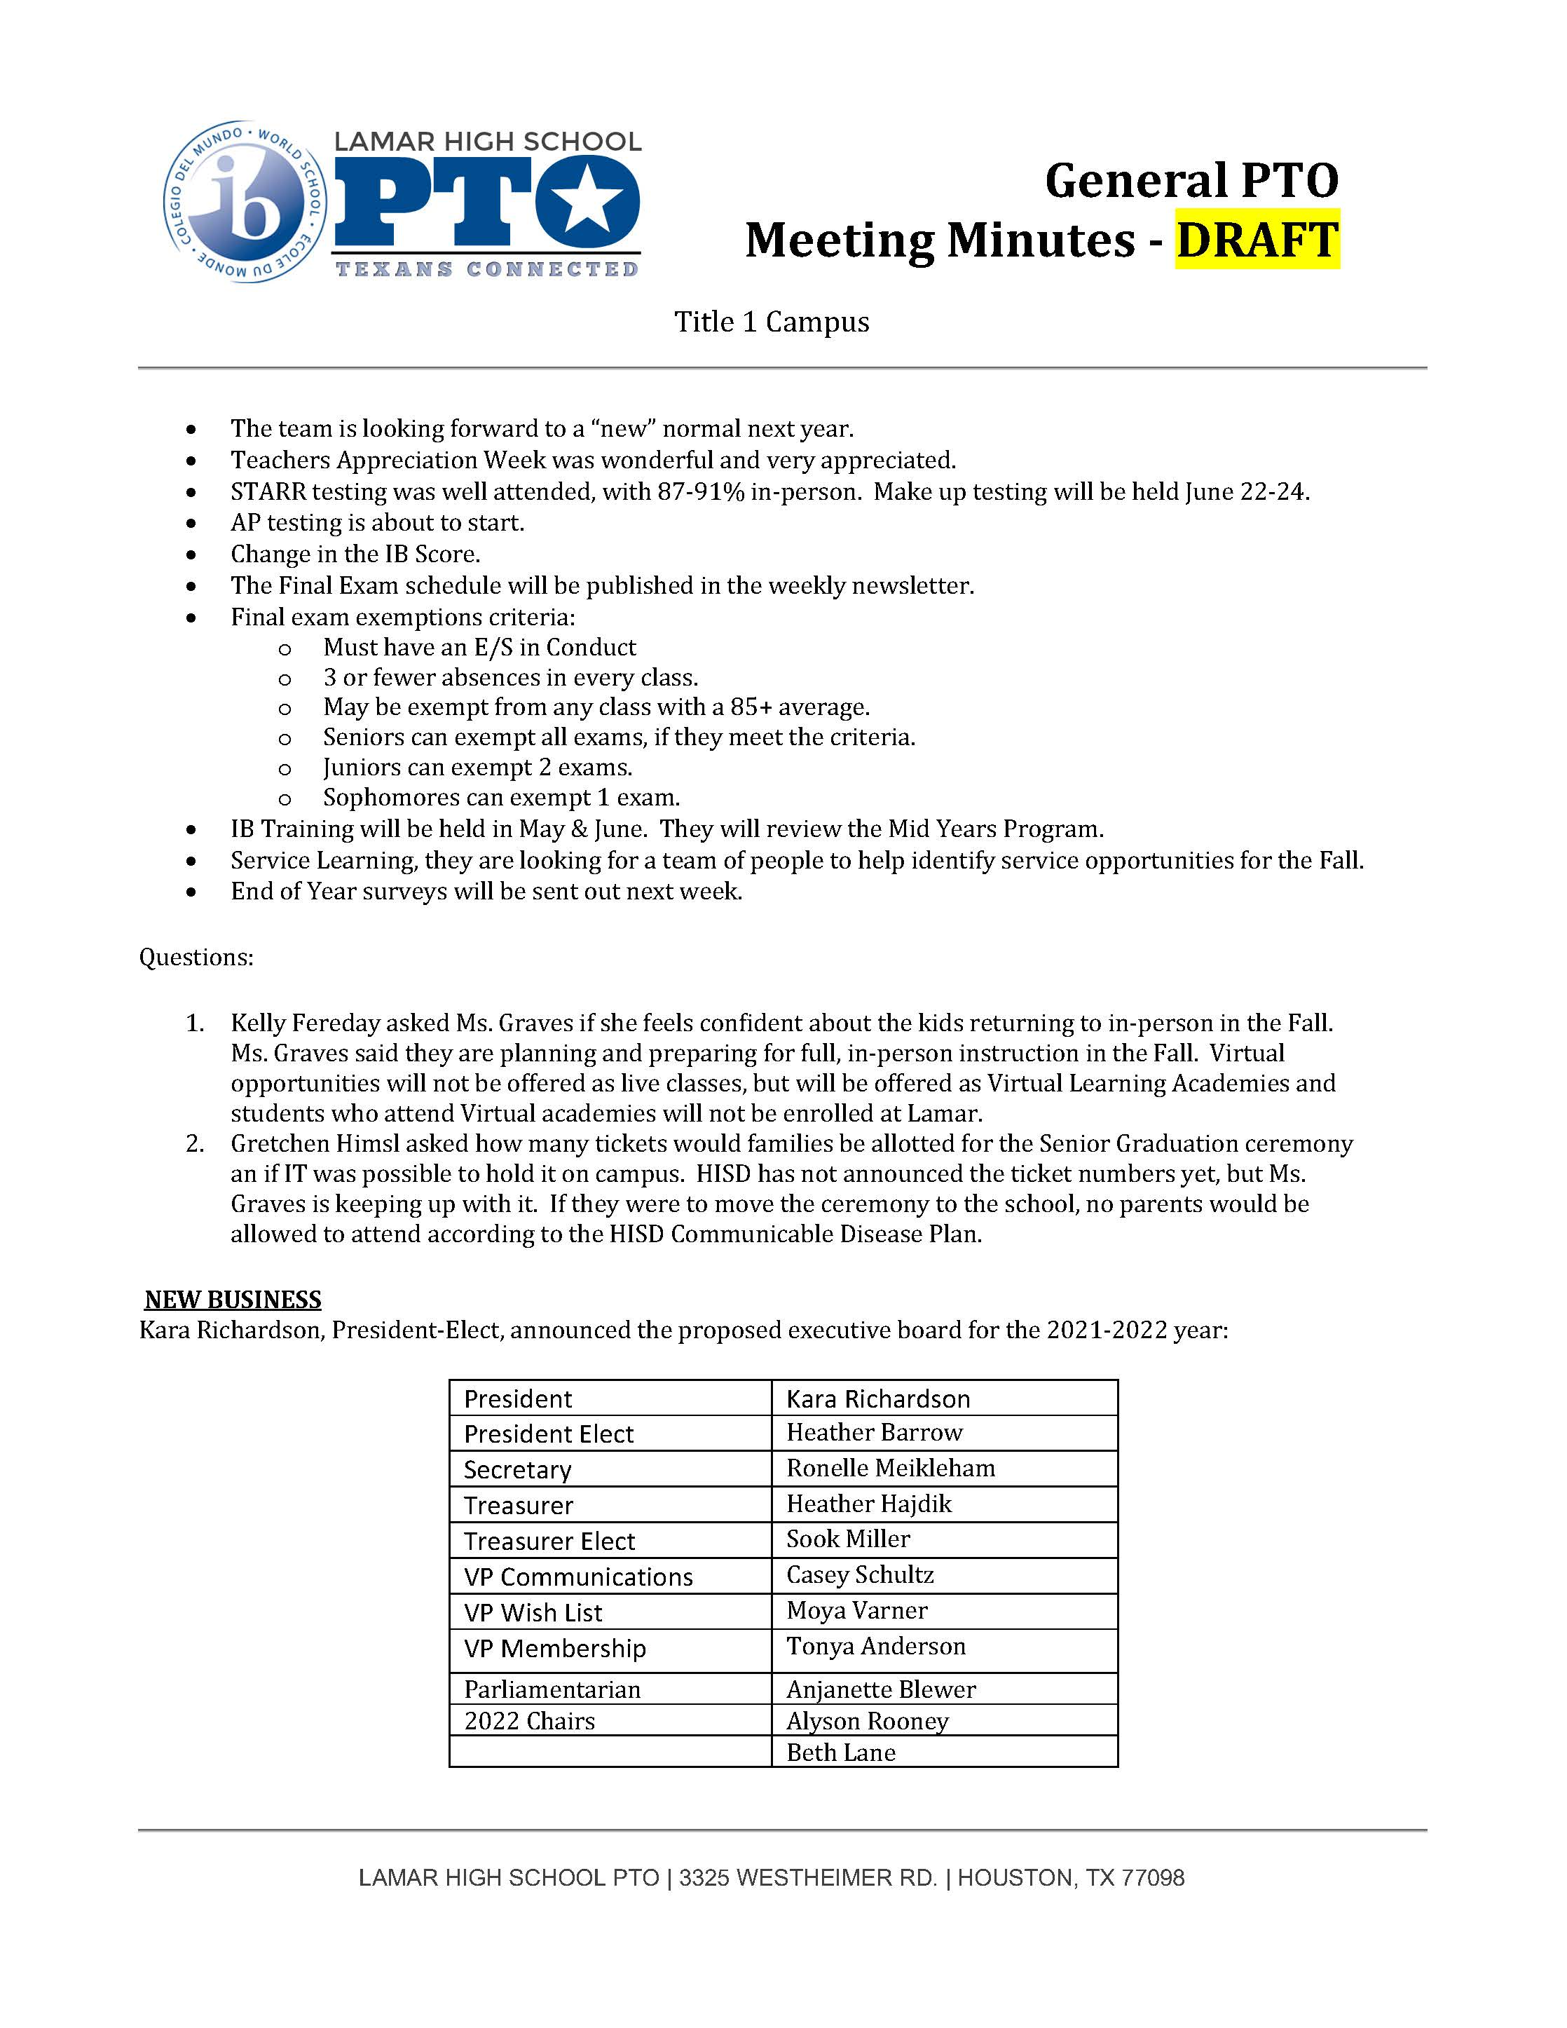
PTO Meeting Minutes - May 11, 2021

Slide 5
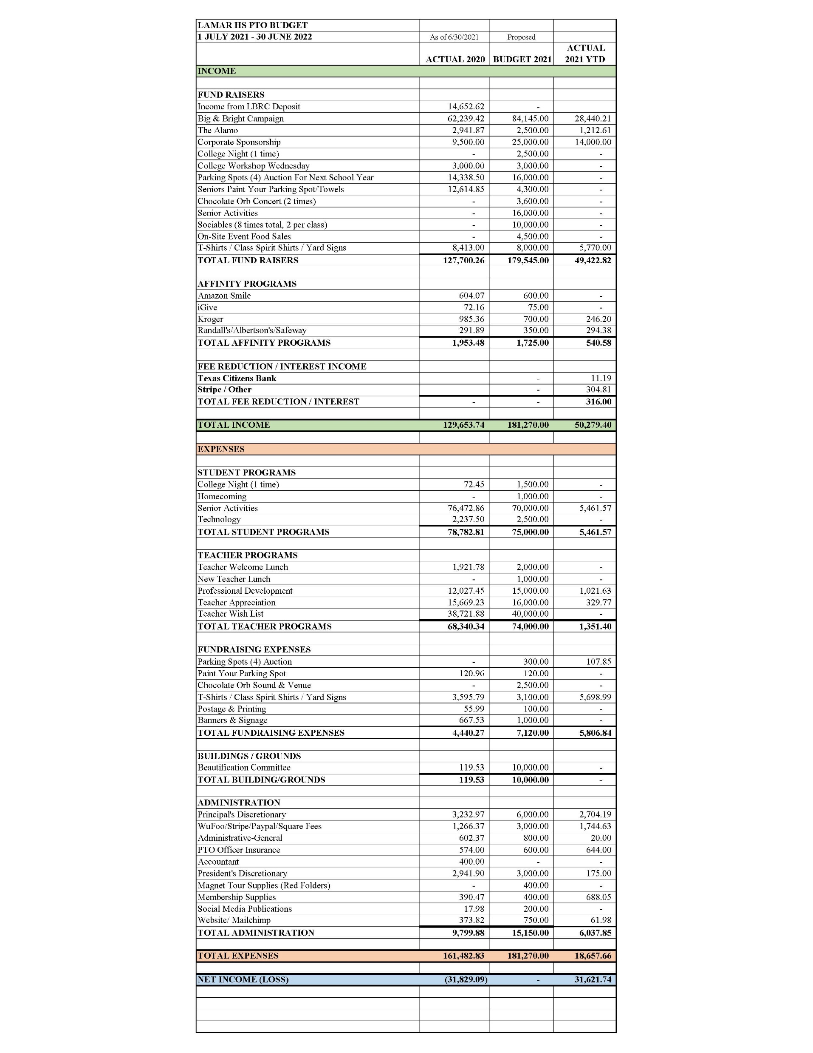
Proposed Budget
Lamar PTO
2021-2022

Slide 6
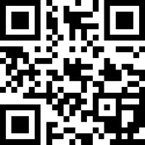
JOIN TODAY! IT’S FREE!
What does the Lamar PTO fund and support?
Instructional Support Items for Classrooms
Teacher and Staff Development Programs * Teacher Appreciation
College Prep Seminars * Texan Connection - PTO Newsletter
Homecoming Events * Lamar Movie Night
Senior Class Activities * Parent Resources
Wraparound Services Donations * Lamar Spirit Shirts & Yard Signs
Campus Improvements & Beautification
TO DATE, WE HAVE 381 FAMILIES WHO HAVE JOINED!

Slide 7
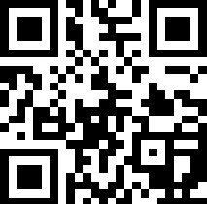
The Big & Bright Campaign is the PTO’s largest fundraiser of the year. Help us reach our goal of $80,000 so that we can fully fund our proposed projects!
To date, we have raised around $30K.

Slide 8
LAMAR CORPORATE SPONSORSHIP CAMPAIGN
SPONSORSHIP
LEVELS
PLATINUM ($7,500 +)
GOLD ($5,000)
SILVER ($2,500)
BRONZE ($1,000)
We need your support!
Please say…..
“YES! OUR COMPANY WOULD LIKE TO BE A CORPORATE TEXAN PARTNER!”
lamarptocorporatesponsors@gmail.com

Slide 9
CORPORATE SPONSORS HELPING TO
lamarptocorporatesponsors@gmail.com
FILL THE GAP
GOLD SPONSORS
$5,000+ Level
SILVER SPONSORS
$2,500+ Level
BRONZE SPONSORS
$1,000+ Level

Slide 10
Loving Lamar Initiative -
SJD’s Loving Lamar Initiative is hosting some parent talks per the below schedule. The talks will start at 6:00 p.m., last for approximately 45 minutes with a 15-minumte Q&A session. The presenter will be a licensed professional counselor from the Nick Finnegan Counseling Center, Tracy Lehman. These talks discuss topics relevant to high school aged children and are open to all parents free of charge.
1. Screens, Social Media, and the Brain (9/21) – (prerecorded presentation starts at 23:00 mark) - VIDEO PRESENTATION
2. Suicide and Self-Harm (10/19)
3. Let’s Talk About Sex (11/16)
SKIP DECEMBER
4. Preparing Your Child for College (1/18)
5. Stress, Burn-Out, and Identity (2/15)
6. Navigating ADHD (3/8)
Public Link to Join Talks: TEAMS LINK TO JOIN TALKS

Slide 11
UPCOMING EVENTS

Slide 12
Oct. 12: Class of 2022 Happy Hour – Kirby Ice House (5 – 7 p.m.)
College Day – Virtual – Saturday October 16 (11 – 2 p.m.)
Oct .18: Class of 2023 Parent Social – Roma Rice Village (5:30 – 7 p.m.)
Oct. 21: Class of 2025 Parent Social – Kirby Ice House (6 – 8 p.m.)
Oct. 23: Homecoming Tailgate – Lamar Sports Field (11 – 2)
Oct. 30: Chocolate Orb Halloween Bash – Rockefeller’s (7 p.m.)
Movie Night – Dec. 4th
EVENTS

Slide 13
Communications LamarPTOcommChair@gmail.com
Lamar HS PTO
@LamarPTO
Mirabeau B. Lamar High School PTO
@LamarHighSchoolHoustonPTO
LamarPTO2020-2021
@lamarpto

